Slide 1
The Power of Great Datasets
Alex Cookson
Twitter: @alexcookson
Email: alexander.cookson@gmail.com
GitHub: github.com/tacookson
Website: www.alexcookson.com
Thank You Allison Horst for the amazing illustration

Slide 2
How do I learn R?

Slide 3
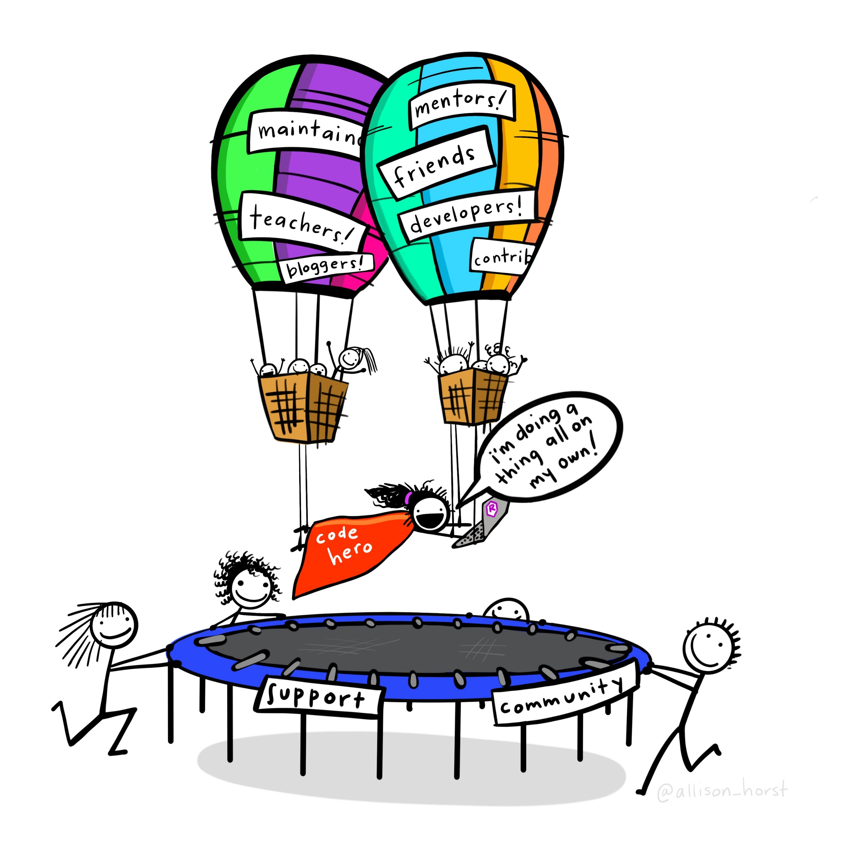
Artwork by @allison_horst

Slide 4
What about
Great Datasets are
?

Slide 5
Great Datasets are COOL

Slide 6
Great Datasets are COOL
and
INTERESTING

Slide 7
Great Datasets are COOL
and
INTERESTING

Slide 8
Great Datasets are COOL
and
INTERESTING
“That’s cool!”
Cool to me isn’t (necessarily) cool to you
Speaks to you on a deeper level

Slide 9
Great Datasets are COOL
and
INTERESTING

Slide 10
Great Datasets are COOL
and
INTERESTING
Prompts you to ask questions
Rouses your curiosity
“Just one more graph”

Slide 11
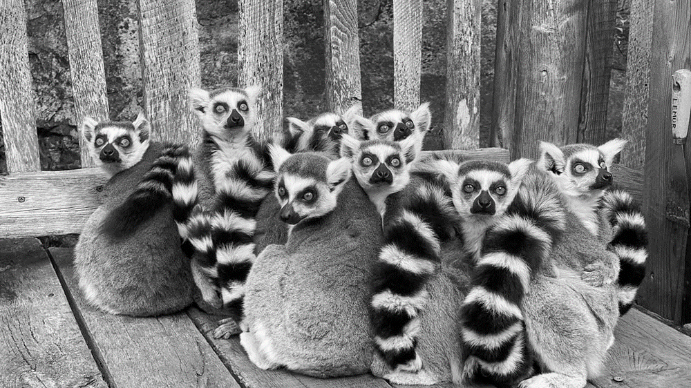
Duke Lemur Center
Ring-tailed Lemurs have an average weight of 2.2kg

Slide 12

Broadway Grosses
Hamilton holds the record for top ticket price on Broadway — $998

Slide 13
Fictional Character Personalities

Slide 14
Fictional Character Personalities

Slide 15
Fictional Character Personalities
Traits of 800 characters across 250+ spectrums

Slide 16
Fictional Character Personalities
Traits of 800 characters across 250+ spectrums
Playful
Serious

Slide 17

Fictional Character Personalities
Traits of 800 characters across 250+ spectrums
Michael Scott
(The Office)
Playful
Serious

Slide 18
Fictional Character Personalities
Traits of 800 characters across 250+ spectrums
Worf
(Star Trek: The Next Generation)
Michael Scott
(The Office)
Playful
Serious

Slide 19
What are some of my favourite characters’ personalities?

Slide 20
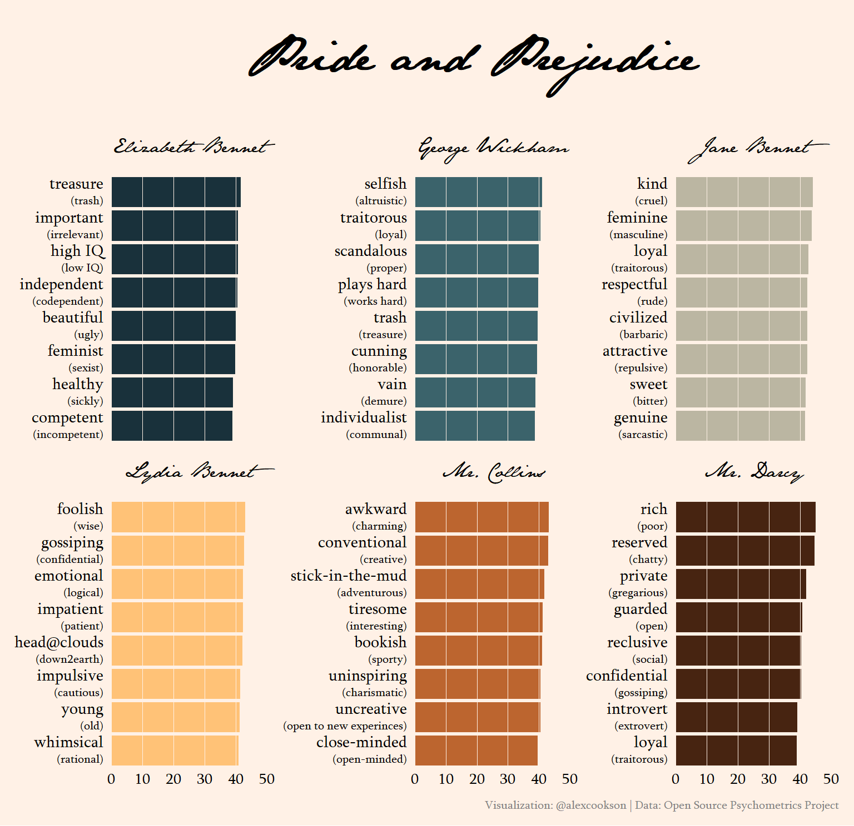

Slide 21
Use custom fonts
Tweak labels with {glue} and {ggtext}
Choose an appropriate colour palette
Adjust a LOT of theme() elements

Slide 22
Which characters are most similar to one another?

Slide 23
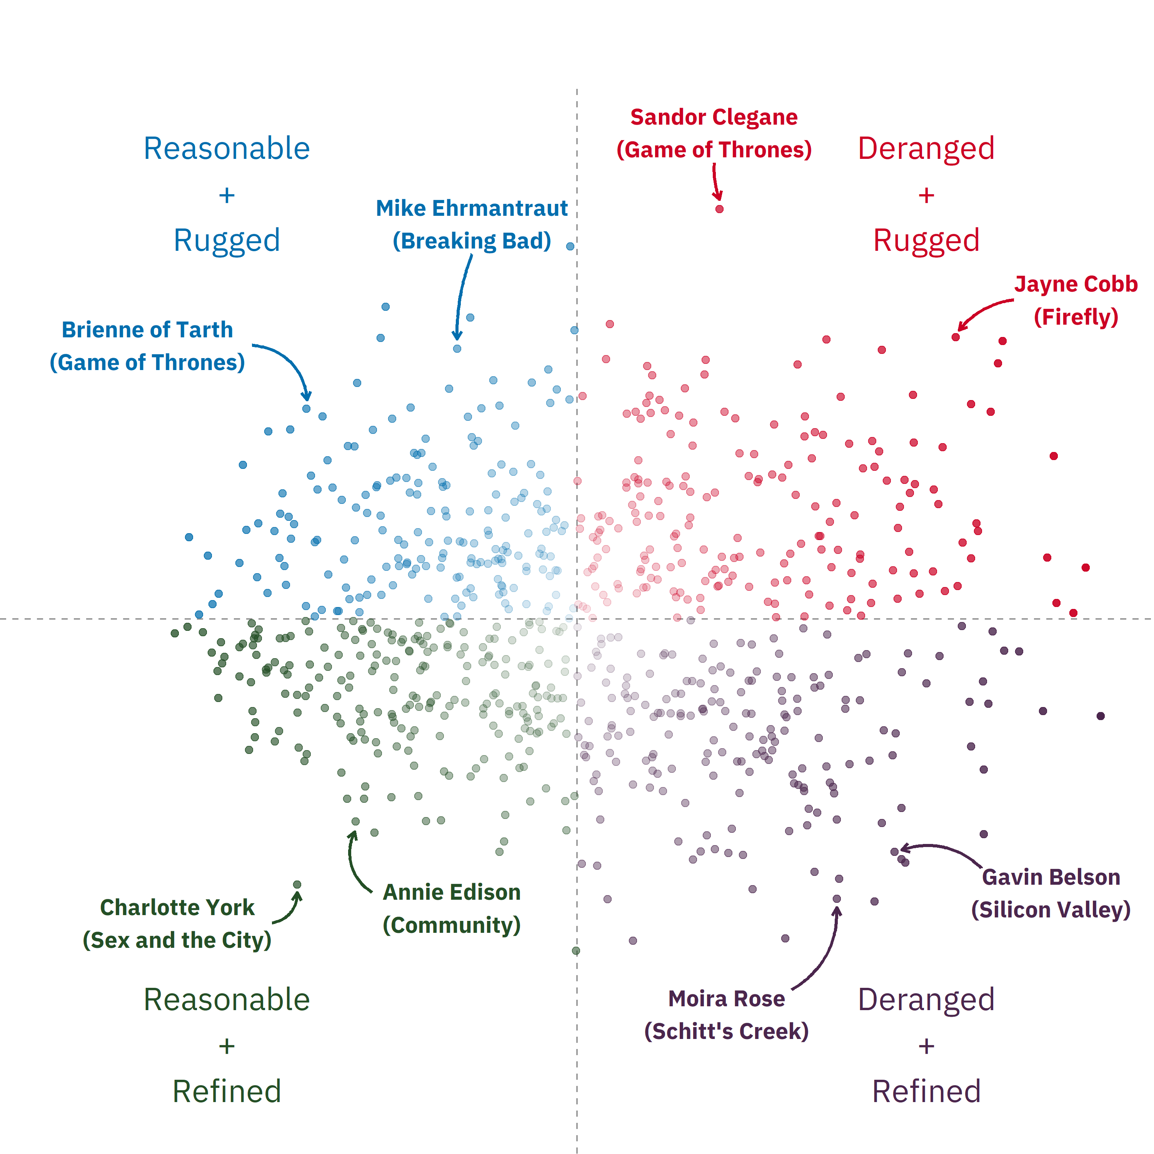

Slide 24
Conduct Principal Component Analysis (PCA) with {tidymodels}
Add text and arrow annotations
Make an interactive chart with {plotly}

Slide 25
I’ll be honest…

Slide 26
I would never put this much effort into analyzing Titanic passengers

Slide 27
Artwork by @allison_horst

Slide 28
great data
Artwork by @allison_horst

Slide 29
The power of Great™ datasets
Alex Cookson

